Slide 1
Data Story Building
Last Updated by: Car (5/4)

Slide 2
GRAPHS TO USE
***Not in Order***

Slide 3
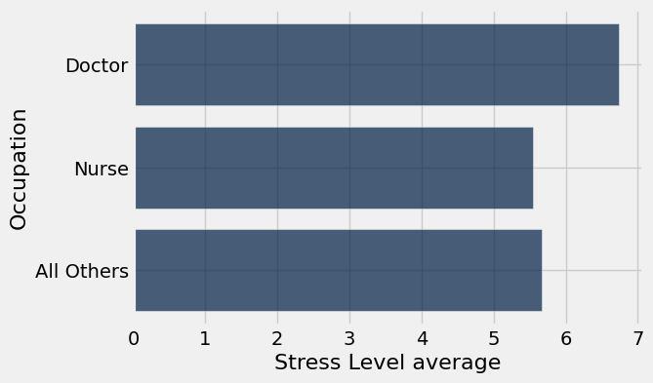
Data Insight: Being a doctor is the most stressful occupation (according to this dataset).
By Brittany Huynh
This graph shows that doctors experienced the highest Stress Level on average compared to nurses and all other occupations. This insight proves the claim from the article in the previous slide that says healthcare workers experience burnout and stress. Doctors’ stress is likely due to physical demands of the job, such as excessive workloads. Doctors are paid extremely well, but does the high salary make up for the stressful nature of the job? Although doctors experience the most stress, nurses’ average stress levels are lower than all other occupations combined.

Slide 4
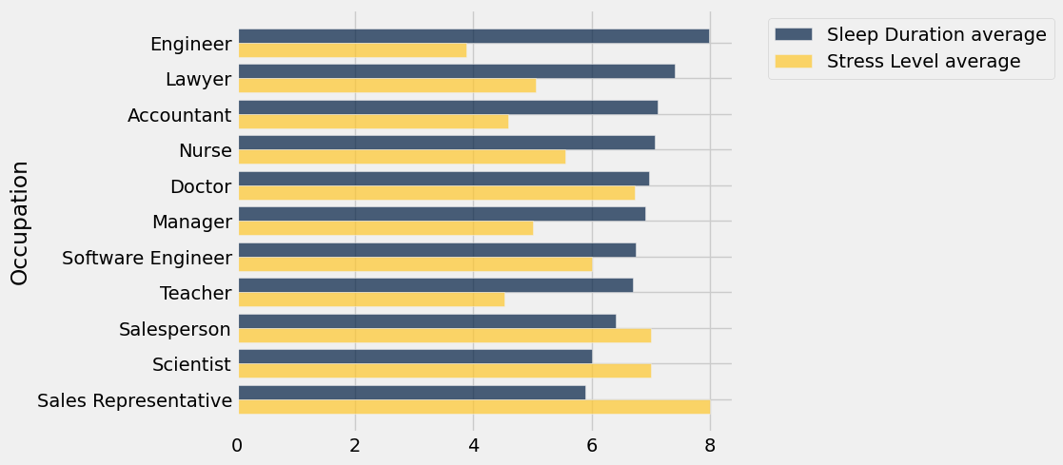
Data Insight: Engineers Sleep the Most, Sales Representatives Sleep the Least – Stress Levels Reflect Sleep Durations.
By Brittany Huynh
This overlaid bar chart shows each occupation’s Sleep Duration average vs. Stress Level average. The data reveals that the occupations with higher sleep durations tend to be less stressed than those with lower sleep durations. The data is making me reconsider my major, maybe I should switch to engineering 😆.

Slide 5
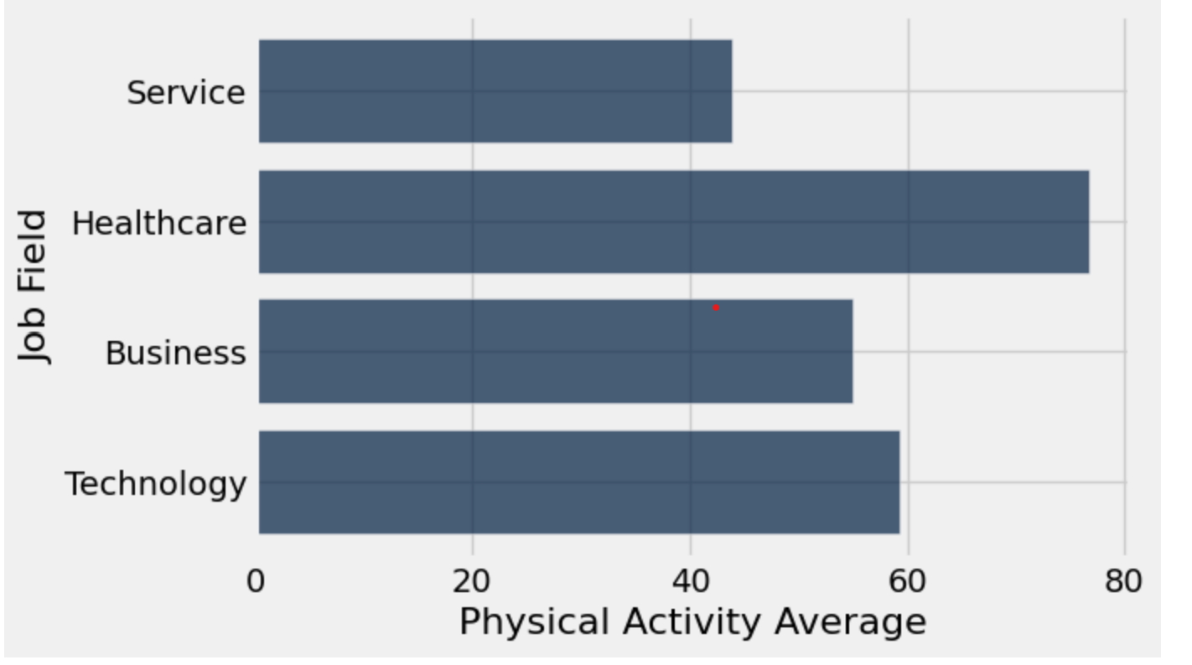
Data Insights
By Carlyn Mangana
This graph shows the various job fields within the data table and how the average physical activity of each job field. The physical activity is on a scale of 0-100, 0 being no physical activity and 100 being very active. Based off of the data results, it seems that healthcare workers have the highest physical activity average. This could be due to the fact that doctors and nurses are always on their feet running around hospitals to tend to those in need. It seems that service workers are the lowest in physical activity average it could indicate that sales representatives these days usually work from home to raise their sales, meaning they don’t need to walk around as much.

Slide 6
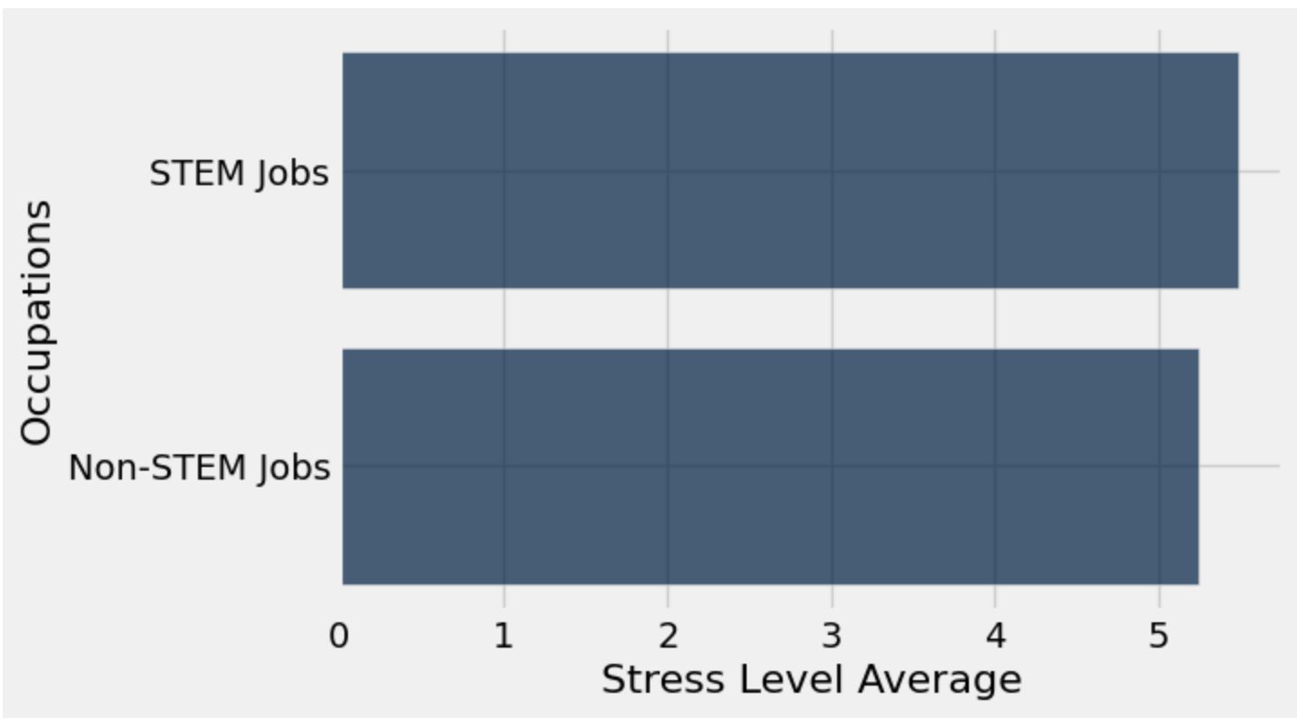
Data Insights
By Carlyn Mangana
This graph shows the difference between those with STEM jobs as well as those in non-STEM job fields. The STEM jobs are based off of the table so they include those who are Software Engineers, Nurses, Doctors, Scientists, and Engineers. The non-STEM jobs are those who are anything outside of those fields in the data table. According to the data, it seems that for the most part they have similar stress levels as I took the average stress level of both those who are in non-STEM and those who are in STEM. This could be due to the fact that despite Lawyer being a non-STEM job, it still has those in the profession working 24/7 on cases and being stressed. This would be something we would take into account when making our final research insights.

Slide 7
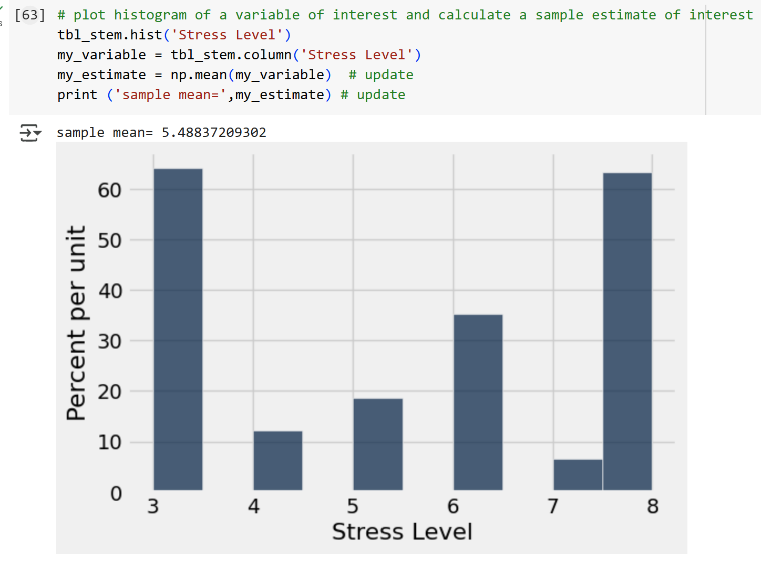
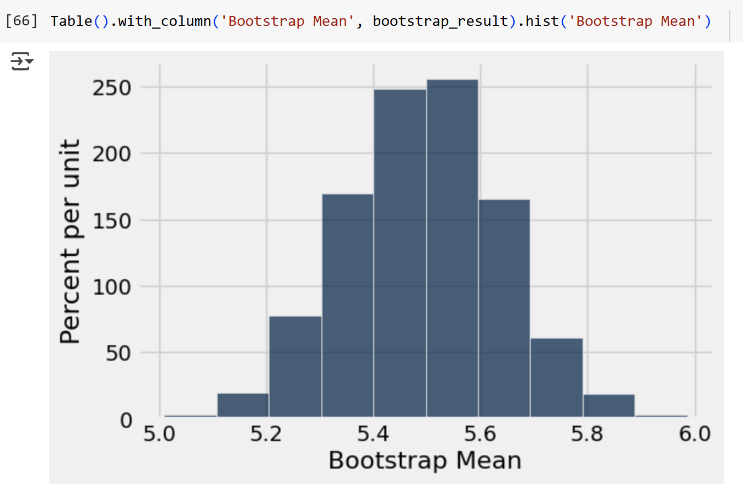
Estimation: STEM Stress Levels
By Carlyn Mangana
I am interested to know if STEM fields have high stress levels compared to Non-STEM
I plan to analyze Stress Levels which describe the average stress levels each person experiences on a scale from 1 being not stressed at all to 10 being very stressed.
My parameter of interest is Mean
95% Confidence Interval of Sample Mean
(5.21, 5.79) meaning that STEM fields are estimated to face average stress levels
95% Confidence Interval of Sample Mean
(5.21, 5.76)
Conclusion: After analysing the data, average stress levels are between 5-6, meaning that most are stressed but not too stressed.

Slide 8
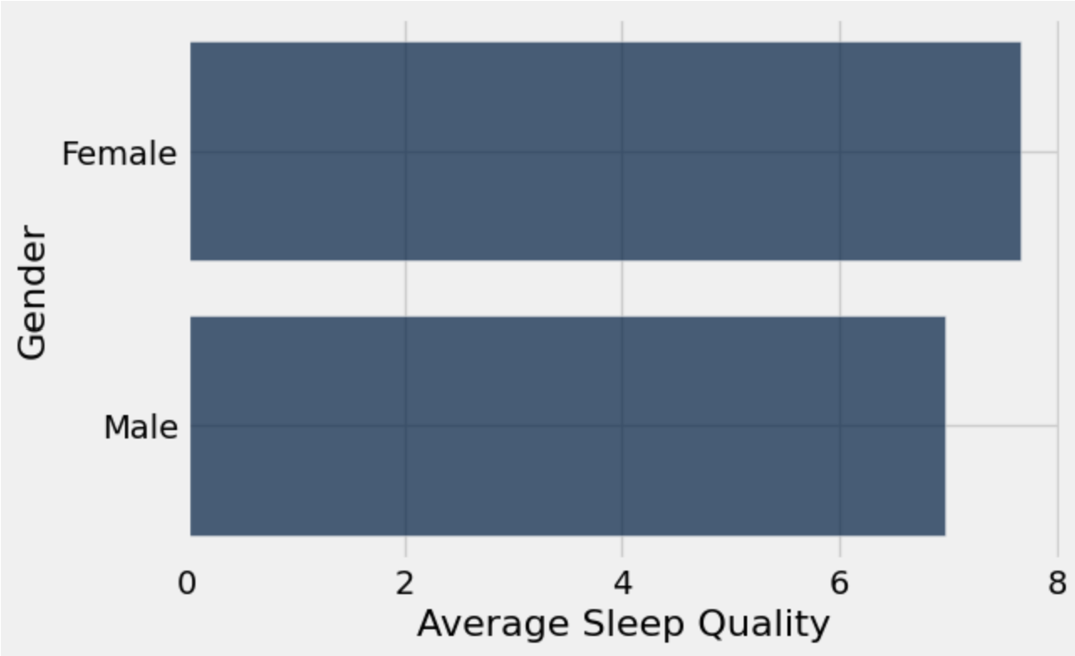
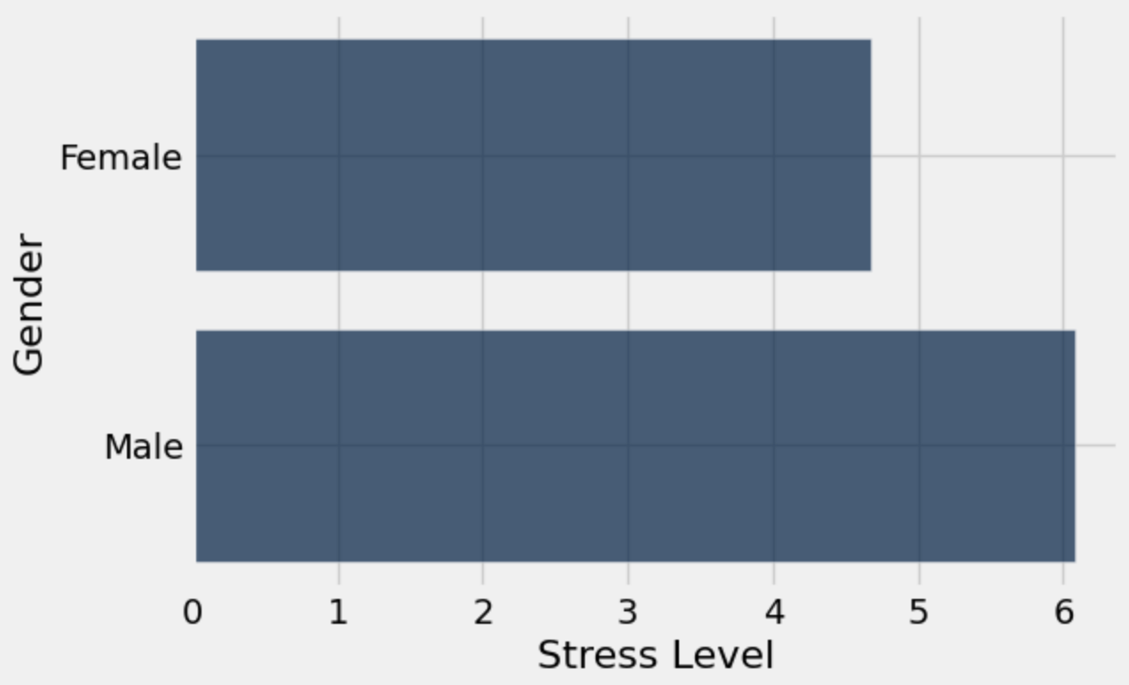
Data Insights
By Carlyn Mangana
Last week, after collection my data insights for this project, I came up with a new curious question, “Does Gender impact all Job Fields?” Based off of these two graphs, it seems that women face better sleep quality but also have lower stress levels. This could be because according to my previous research, women face gender disparities when it comes to career advancements, therefore, they have less opportunities to get these higher level careers.

Slide 9

By Brittany Huynh
Average Female Engineer Data 🛠️
53 Years Old
9 out of 10 Sleep Quality Score 💤
3 out of 10 Stress Level Score 🧘🏻‍♀️
5000 Daily Steps 🏃🏻‍♀️
30 Physical Activity Level
Normal Weight (BMI 18.5-24.9)
https://iheartcraftythings.com/cartoon-woman-drawing.html
Link to source
Female engineers are one of the least stressed individuals in this dataset. They also live relatively healthy lifestyles with a high overall sleep quality score, a normal level of daily physical activity, and normal weight BMI category.

Slide 10
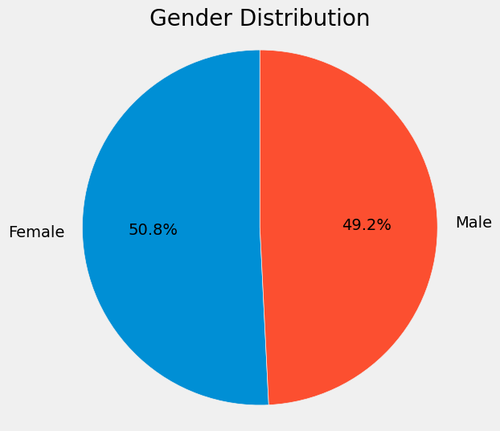
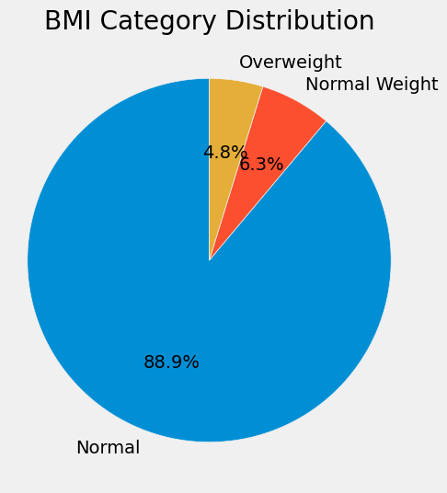
Exploring the Lifestyles of Engineers (The Least Stressed Occupation)
By Brittany Huynh
Gender | Quality of Sleep average | Age average | Stress Level average | Physical Activity Level average | Daily Steps average
Female | 9 | 52.7812 | 3 | 30 | 5000
Male | 7.80645 | 40.1935 | 4.80645 | 74.4194 | 6993.55
There are 63 total engineers in this dataset, with the gender makeup being nearly equal. From my previous insight, we find out that engineers are the occupation with the lowest stress level. Out of curiosity, I explored their lifestyle habits. I found that on average, female engineers are older, less stressed, and less physically active than male engineers. Overall, engineers live fairly healthy lifestyles, which explains their lower stress levels.

Slide 11
UNUSED GRAPHS

Slide 12
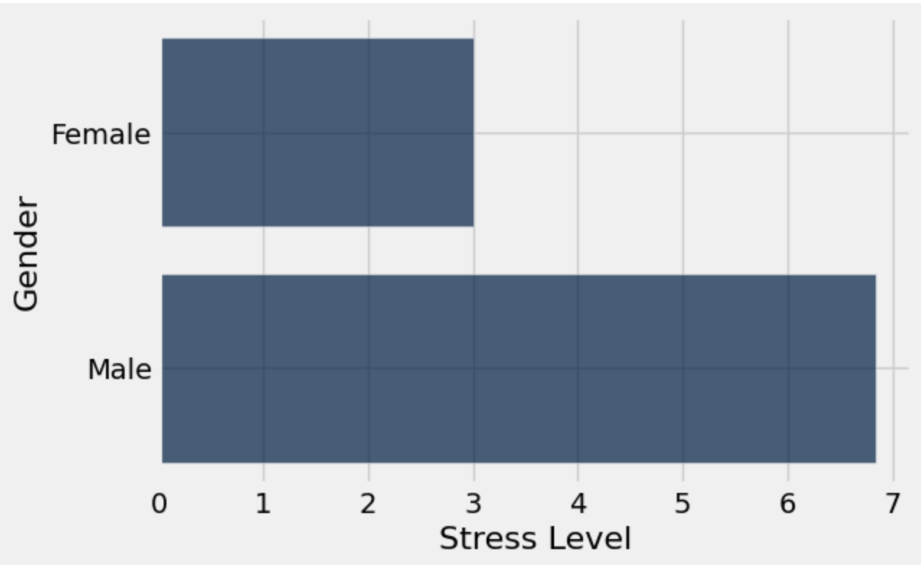
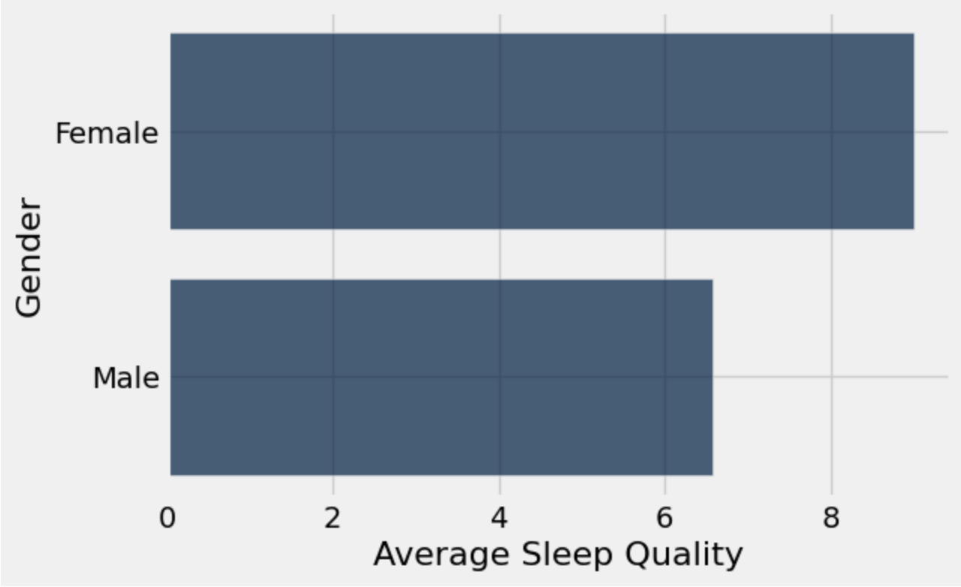
Data Insights
By Carlyn Mangana
Based off of previous feedback, I decided to separate my data from my curious question “Does Gender Impact the Doctor Lifestyle?” This made my data look a lot easier to read as well as made it clear that men face higher stress levels and poorer sleep quality compared to the women within the data.

Slide 13
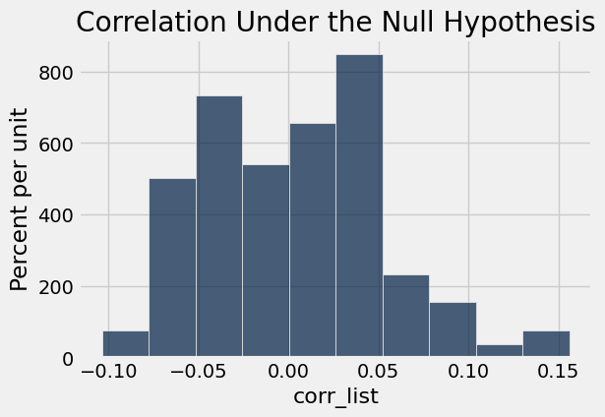
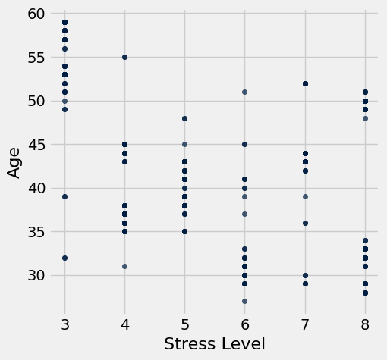
Permutation Test: Age vs. Stress Level
By Brittany Huynh
Observed correlation: -0.898752031004
p-value<0.001
-0.898752031004
Conclusion:
Layman’s version: there is strong evidence supporting the claim that older age is associated with lower stress level.
Scientific version: assuming null hypothesis that there is no relationship between age and stress level, the chance of seeing a difference at -0.899 or larger is less than 0.001. We reject the null hypothesis at a significance level of 0.001
H0: there is no association between Age and Stress Level
H1: Older age is associated with lower stress level and vice versa.

Slide 14
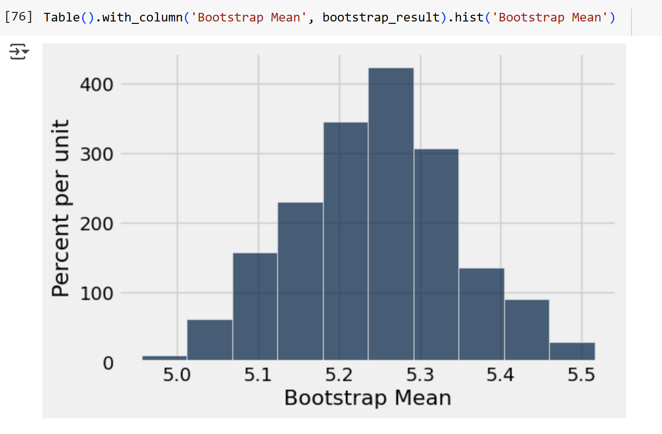
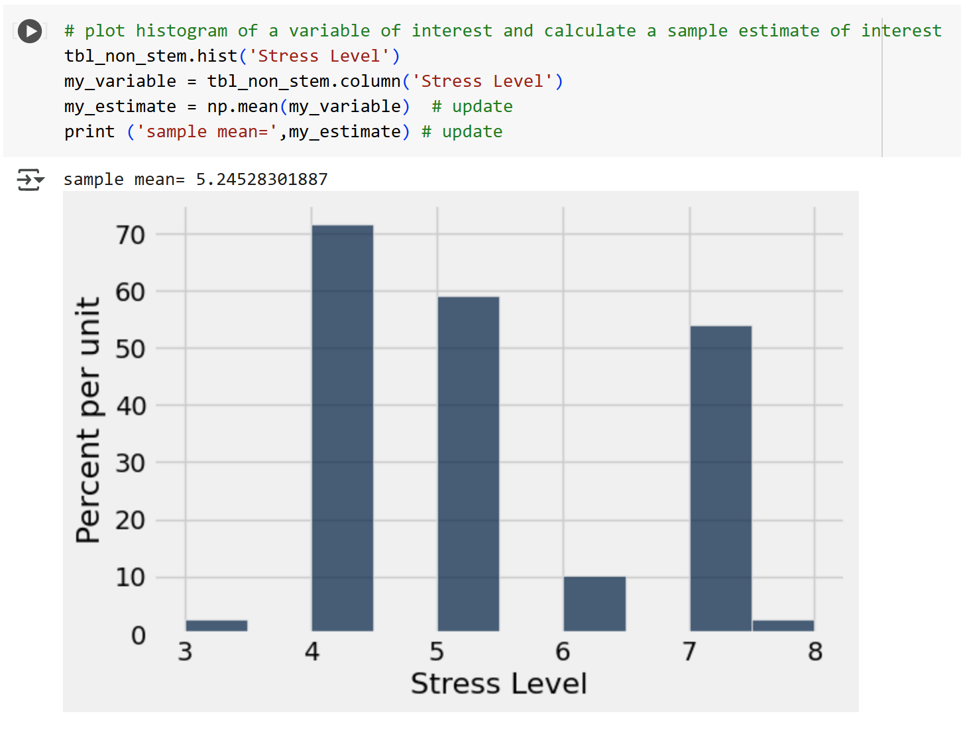
Estimation: Non-STEM Stress Levels
By Carlyn Mangana
I am interested to know if STEM fields have high stress levels compared to Non-STEM
I plan to analyze Stress Levels which describe the average stress levels each person experiences on a scale from 1 being not stressed at all to 10 being very stressed.
My parameter of interest is Mean
95% Confidence Interval of Sample Mean
(5.05, 5.43) meaning that Non-STEM fields are estimated to face average stress levels
95% Confidence Interval of Sample Mean
(5.05, 5.44)
Conclusion: After analysing the data, average stress levels are between 5-6, meaning that most are stressed but not too stressed. Overall, both STEM and Non-STEM stress levels are similar to each other despite have differing graphs.

Slide 15
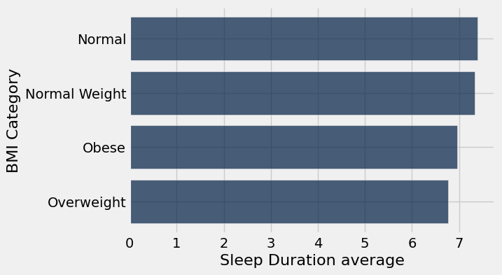
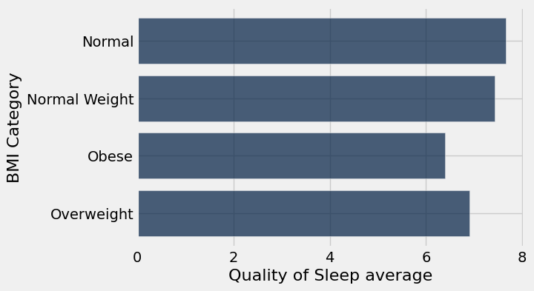
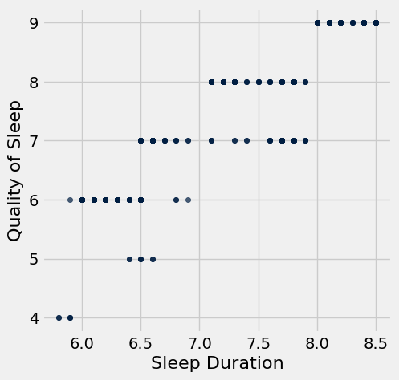
Data Insight: Overweight and Obese people sleep less and get poorer quality sleep than people with Normal weight.
By Brittany Huynh
BMI Category | count
Normal | 195
Normal Weight | 21
Obese | 10
Overweight | 148
The two bar charts show the relationship between BMI category, Sleep Duration average and Quality of Sleep average. The scatter plot shows the relationship between Sleep Duration and Quality of Sleep – the pattern reveals that longer Sleep Duration is linked to higher Quality of Sleep score. The bar charts show that on average, people in the Overweight and Obese BMI category have lower sleep duration and poorer quality of sleep than those in the Normal weight BMI category. This article written by bariatric surgeon, Muhammad Ghanem, claims that poor sleep quality slows metabolism and increases appetite and cravings for junk food. The bar charts reflect the statement that sleep is very important, especially when it comes to weight management. This finding makes me wonder whether there is a correlation between occupation and sleep quality.

Slide 16
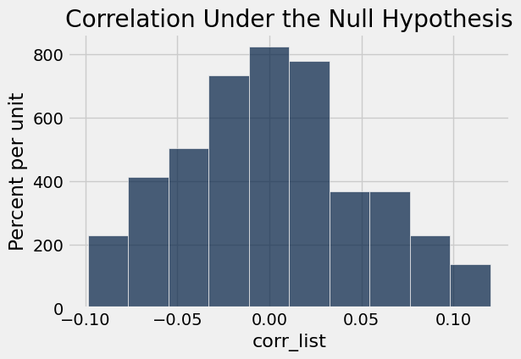
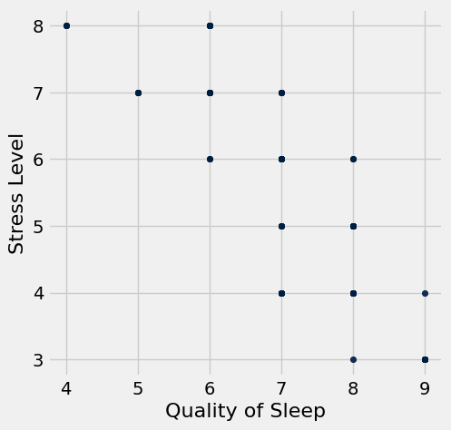
Permutation Test: Quality of Sleep vs. Stress Level
By Brittany Huynh
Observed correlation: -0.898752031004
p-value<0.001
-0.898752031004
Conclusion:
Layman’s version: there is strong evidence supporting the claim that higher sleep quality leads to lower stress levels.
Scientific version: assuming null hypothesis that there is no relationship between stress level and quality of sleep, the chance of seeing a difference at -0.899 or larger is less than 0.001. We reject the null hypothesis at a significance level of 0.001
H0: there is no association between Stress Level and Quality of Sleep
H1: Higher sleep quality leads to lower stress levels

Slide 17
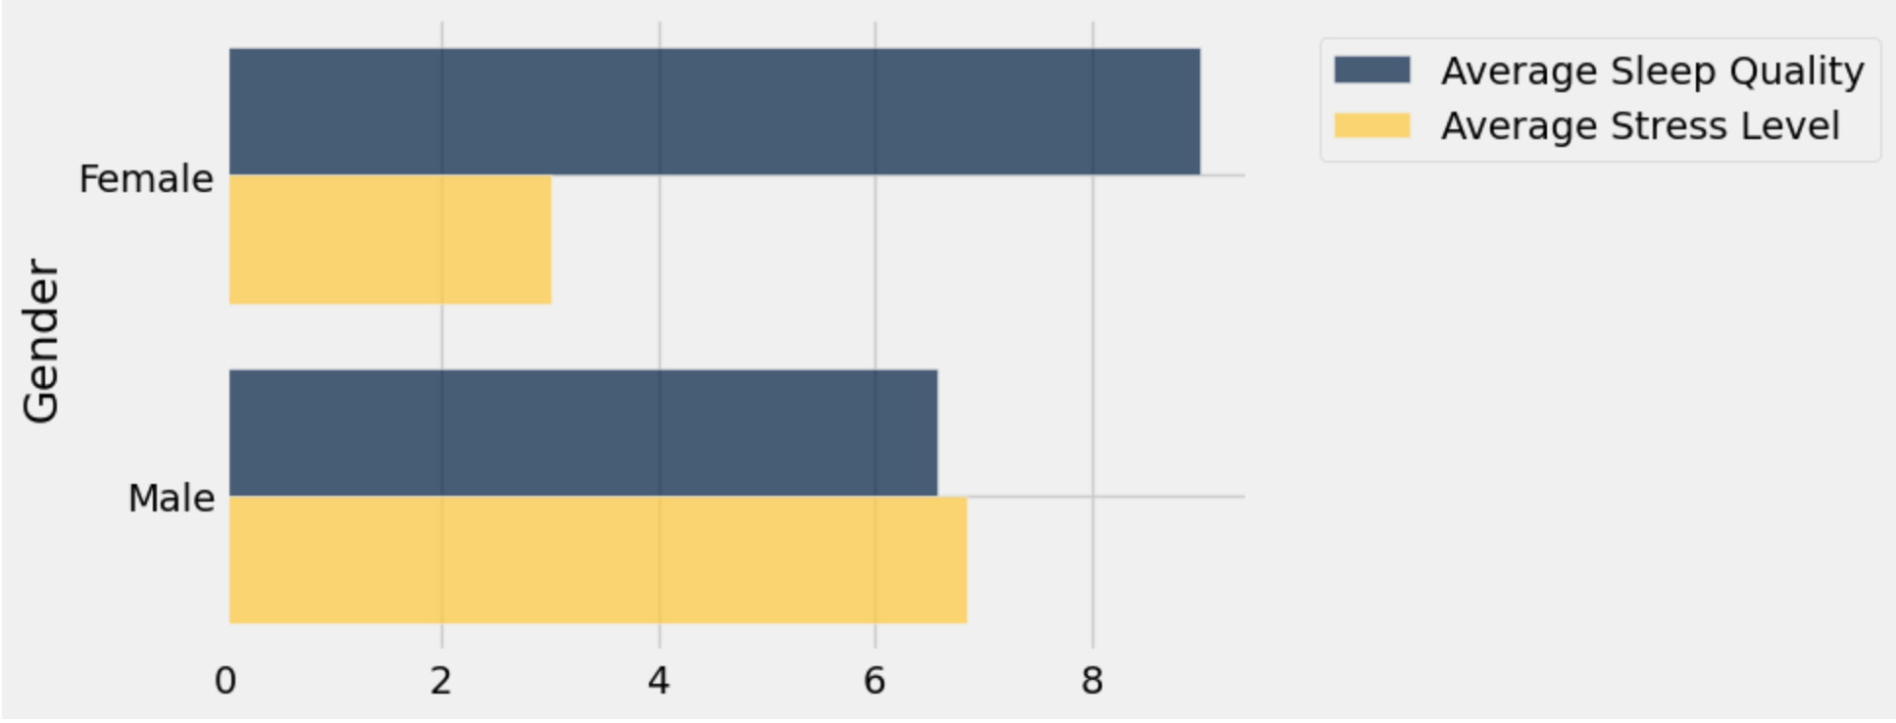
Data Insights
By Carlyn Mangana
This graph shows the average stress level and sleep quality for both female doctors and male doctors indicating that female doctors sleep better than male doctors but have more stress on them. This made me question why this was and a part of me was considering that it could be because within the data table there were far more male doctors than female doctors, however, I wanted to dig deeper and get more insightful answers.

Slide 18
Data Insights
By Carlyn Mangana
This article that I found explained that female doctors have a higher workload compared to male doctors but also receive fewer resources and less control over their workload and schedules. It also reported that women lack in leadership roles and face a compensation disparity which could explain why there were fewer female doctors than male doctors. There are also less rate of career advancements for them and this may cause lower self-compassion and higher stress levels. This ties into my theory that the reason there was less female doctors than male doctors within the data was because of there being gender inequality within the work field, causing it to impact the two differing genders differently. This caused me to ask another curious question,
Does this impact the doctor field or does this result happen in all job fields?
Source: Gender Differences in Physician Burnout: Driving Factors and Potential Solutions

Slide 19
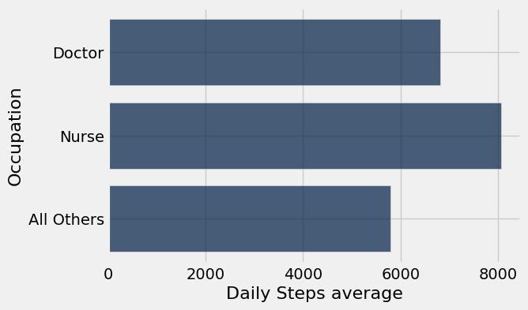
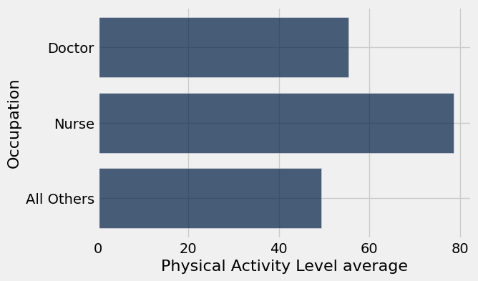
Data Insight: Doctors and Nurses are more physically active than all other occupations on average.
By Brittany Huynh
These bar graphs show the Daily Steps average and Physical Activity Level average of Doctors, Nurses, and all other occupations. These graphs are used to answer my curious question, “Are doctors more physically active than non-doctors?” This insight is similar to Car’s insight on the previous slide. The data shows that both doctors and nurses are more physically active than all other occupations in the dataset, including workers in sales, engineering, education, and more. It’s a well-known fact that moderate amounts of daily physical activity improve well-being, boost heart health, and help maintain a healthy weight. However, this article claims that healthcare workers experienced significant burnout and stress, especially during the height of the COVID-19 pandemic. This leads to me to pose another question, how do the stress levels of doctors and nurses compare to all other occupations in this dataset?

